Slide 1
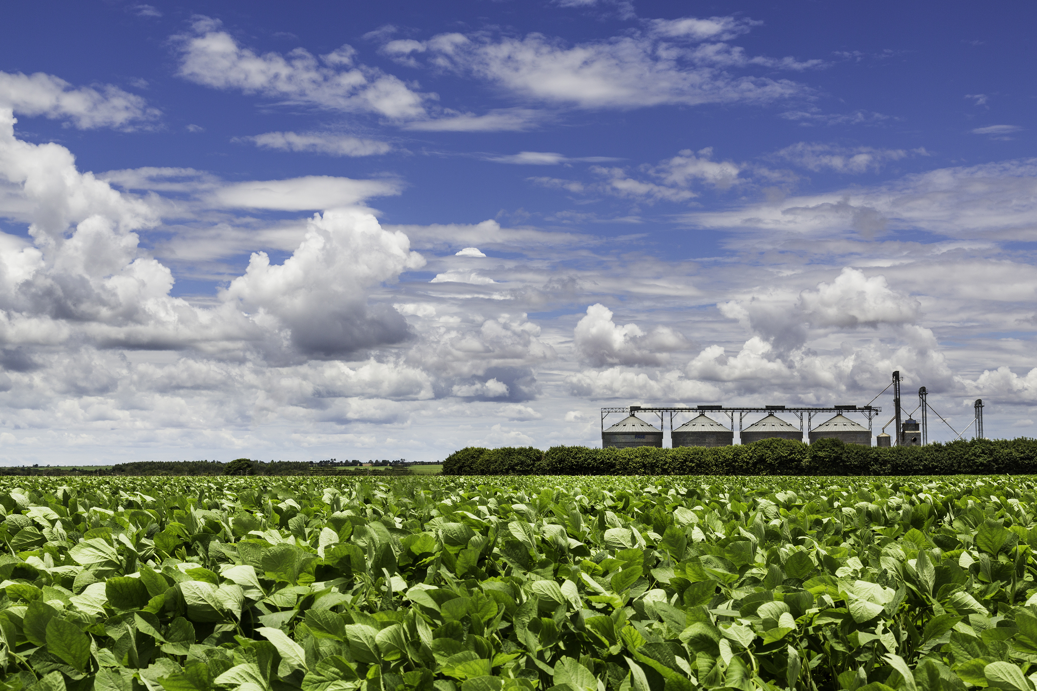
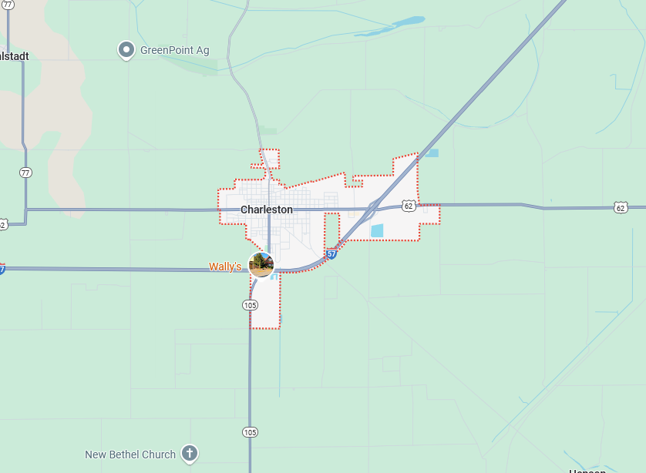
Charleston, Mississippi County, MO
Average Annual Precipitation:
36.05”
Drought Frequency:
65% of the time
High-Impact Drought Frequency:
20% of the time
Most Common Onset Season:
Summer
Most Common Relief Season:
Spring
Average Drought Length:
15 Months
Average High-Impact Drought Length:
6 Months
Longest Drought:
30 Months

Slide 2
Spring Drought Chart
City, County | D0 | D1 | D2 | D3 | D4
Albany, Gentry | 0.3” | 0.15” | 0.05” | 0.03” | 0.0”
Auxvasse, Audrain | 0.3” | 0.15” | 0.05” | 0.03” | 0.0”
Brunswick, Carroll | 0.3” | 0.15” | 0.05” | 0.03” | 0.0”
Cardwell, Dunklin | 0.3” | 0.15” | 0.05” | 0.03” | 0.0”
Charleston, Mississippi | 0.3” | 0.15” | 0.05” | 0.03” | 0.0”
Clarkton, Dunklin | 0.3” | 0.15” | 0.05” | 0.03” | 0.0”
Columbia-Sanborn Field, Boone | 0.3” | 0.15” | 0.05” | 0.03” | 0.0”
Columbia-South Farms, Boone | 0.3” | 0.15” | 0.05” | 0.03” | 0.0”
Cook Station, Crawford | 0.3” | 0.15” | 0.05” | 0.03” | 0.0”
Corning, Atchison | 0.3” | 0.15” | 0.05” | 0.03” | 0.0”
Delta, Cape Girardeau | 0.3” | 0.15” | 0.05” | 0.03” | 0.0”
Glennonville, Dunklin | 0.3” | 0.15” | 0.05” | 0.03” | 0.0”
Hayward, Pemiscot | 0.3” | 0.15” | 0.05” | 0.03” | 0.0”
Lamar, Barton | 0.3” | 0.15” | 0.05” | 0.03” | 0.0”
Linneus, Linn | 0.3” | 0.15” | 0.05” | 0.03” | 0.0”
Monroe City, Monroe | 0.3” | 0.15” | 0.05” | 0.03” | 0.0”
Novelty, Knox | 0.3” | 0.15” | 0.05” | 0.03” | 0.0”
Portageville, Pemiscot | 0.3” | 0.15” | 0.05” | 0.03” | 0.0”
St. Joseph, Buchanan | 0.3” | 0.15” | 0.05” | 0.03” | 0.0”

